Slide 2
MAP

Slide 3
GLOBES AND MAPS

Slide 5
PARTS OF A MAP

Slide 7
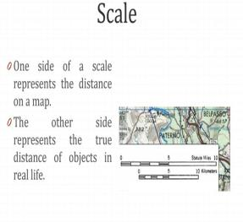
MORE ABOUT MAPS /Social/N Karunambigai//SNS ACADEMY

Slide 8
SCALE ON A MAP
SCALE

Slide 9
SYMBOLS

Slide 10
SYMBOLS

Slide 11
TYPES OF MAPS
MORE ABOUT MAPS/Karunambigai/Social/SNS ACADEMY

Slide 12
PHYSICAL MAPS

Slide 13
POLITICAL MAPS

Slide 14
THEMATIC MAPS

Slide 15
PLAN

Slide 16
SKETCH

Slide 17
https://www.youtube.com/watch?v=QcsFm_57Tdc

